Slide 1

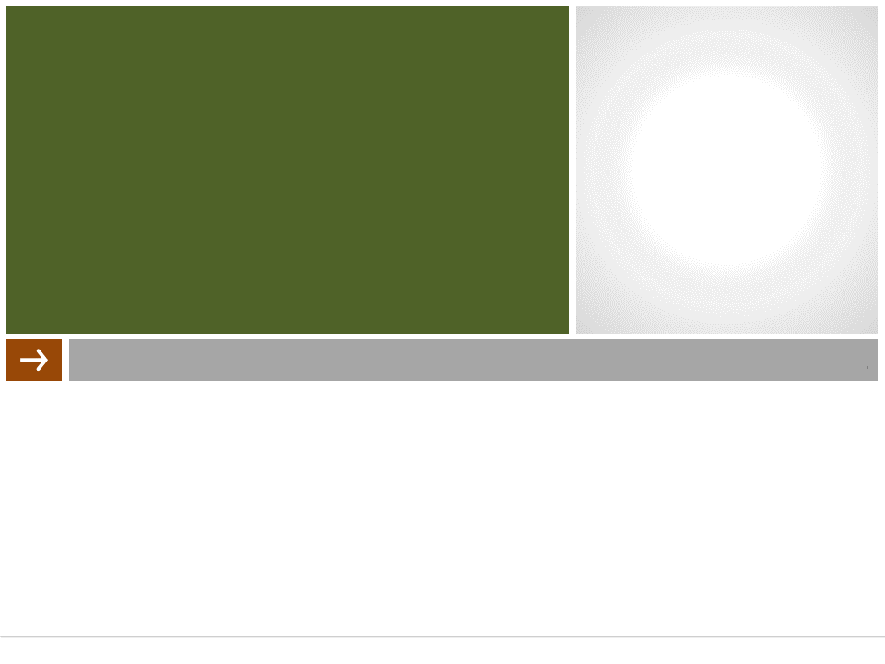
SHORT VIDEO APPLICATION PROJECT REPORT
Group 17
Introduction to
Software Engineering

Slide 2
MEMBERS
20120232 – Võ Duy Trường
20120175 – Lê Thái Như Quỳnh
20120188 – Lê Trần Thiện Thắng
20120215 – Trần Minh Toàn
20120382 – Hoàng Thu Thủy

Slide 3
TABLE OF CONTENTS
1. Problem Statement
2. Product Position Statement
3. Users/Market
4. Project Management
5. Software Requirement
6. Analysis and Design
7. Software Testing
8. Demo a Test case

Slide 4
1. Problem Statement
The problem of | Common types of information such as long texts or videos begin to bring boredom to social network users.
affects | Social media users, content creators and enterprises

Slide 5
1. Problem Statement
the impact of which is | Social network users feel bored, content creators have to invest too much in long content while the reach is decreasing. Therefore, information and advertising are also difficult to reach social network users.
a successful solution would be | The proposed solution is to shorten the transmission of information.

Slide 6
2. Product Position Statement
For | social media users and content creators
Who | watch, post, react, download short videos.
The (product name) | Is short video application
That | increase users' interest in the information posted, reduce the time to read/view a content, increase the amount of content we can access.

Slide 7
2. Product Position Statement
Unlike | Youtube, Facebook, Instagram, etc. They just integrate the short video part into the existing app instead of its own app
Our product | can ensure the cleanliness of the posted content.

Slide 8
3. Users/Market
Name | User | Creator | Businessman
Opinion | People use the app for entertainment, just watch and interact with videos. | Content creators who produce, edit videos and publish them. | Through the app to run ads
Skill | basic social networking | content creation, channel theme orientation, innovation, creativity, advertising | contact, deal, social network reviews, event organization

Slide 9
3. Users/Market
Name | User | Creator | Businessman
Roles, duties, Responsibili- ties | The user is the main target audience of the application. Users are responsible for reacting and commenting on videos that they find useful, thereby pushing those videos to trend. This also helps interesting information will reach more people. In addition, users following accounts they like is also an incentive for creators. | Content creators are the foundation of the app. They create content, engage viewers, and make apps great. Their main responsibility is to create relevant, fresh content that attracts a steady stream of viewers and a trending audience. | Entrepreneurs are the main source of income for management and creators. Their respon-sibility is to find the right channel for the product they advertise, and send the product to the channel owners for them to advertise or use. Of course, these will cost money, but their products will also be known to more viewers.

Slide 10
3. Users/Market
Name | User | Creator | Businessman
Computer experience, professional experience | basic | average, focusing on software to support writing, designing, editing | average, focus on market analysis, data analysis.
Frequency of application usage | often (1h – 2hs/day) | Frequent (4hs – 8hs/day) | Frequent (4hs – 8hs/day)
Age, gender, culture, interests | All ages, genders, cultures. They love to explore and spend a lot of time entertaining | All ages, genders, cultures. They like to be creative and give information | Adults, all genders and all cultures.

Slide 11
3. Users/Market
Name | User | Creator | Businessman
Habit | Use social media every day. | None | None
Desire | The app features clean content filtering. | Easy to use | The application is transparent in the amount of tracking accounts.
Limit | 30-50 | (Currently don’t support) | (Currently don’t support)
Other | None | None | None

Slide 12
4. Project Management
Vo Duy Truong
Project Manager
Tran Minh Toan
Le Tran Thien Thang Le Thai Nhu Quynh
Hoang Thu Thuy Vo Duy Truong
Developer
Hoang Thu Thuy
Business Analyst
Tran Minh Toan
Le Tran Thien Thang
Le Thai Nhu Quynh
Vo Duy Truong
Designer
Le Thai Nhu Quynh
Tester
Team Structure

Slide 13
4. Project Management
Responsibilities of Team member
Student ID | Name | Responsibilities
20120232 | Vo Duy Truong | project manager, developer, designer
20120175 | Le Thai Nhu Quynh | developer, tester, designer
20120188 | Le Tran Thien Thang | developer, designer
20120215 | Tran Minh Toan | developer, designer
20120382 | Hoang Thu Thuy | developer, business analyst

Slide 14
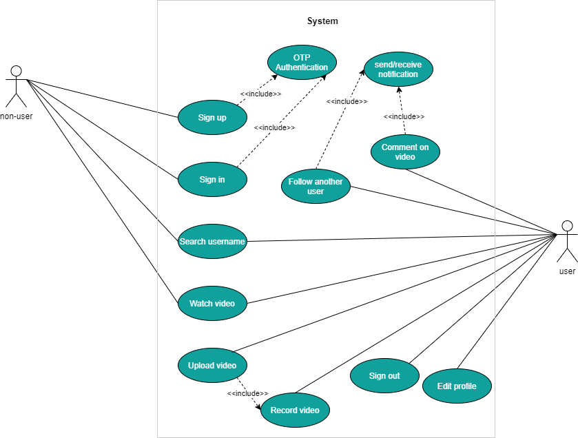
5. Software Requirement

Slide 15
5. Software Requirement
Non-functional requirement
Availability | Users can use the application at any time except during system maintenance.
Integrity | Videos and comments which user posted or liked will be stored at database so that the app can access and use to render view when this user authenticate successfully
Usability | Users can watch, post, comment, and like videos easily. Support dark mode.

Slide 16
6. Analysis and Design
Tools Used
Storing and sharing documents and files | Onedrive
Managing source code and related files | Github
Saving data, management database | Firebase, Cloud firestore
Meeting | Google Meet
Communication | Facebook
Project management | Trello, Slack

Slide 17
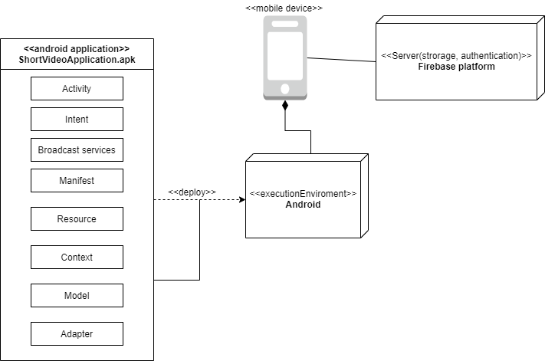
6. Analysis and Design
Tools Used

Slide 18
7. Software Testing
Hardware Requirements
Android device have minimum version is 9.0 or PC which in-stalled android studio.

Slide 19
7. Software Testing
Software in the test environment
Software Name | Purpose | Version | Type and Other Notes
Android studio |  |  | The official Integrated Development Environment (IDE) for Android app an automation
Katalon studio |  |  | Testing software

Slide 20
7. Software Testing
Productivity and Support Tools
Tool Category or Type | Tool Brand Name | Vendor or In-house | Version
Defect Tracking | MS Excel | MS | 365

Slide 21
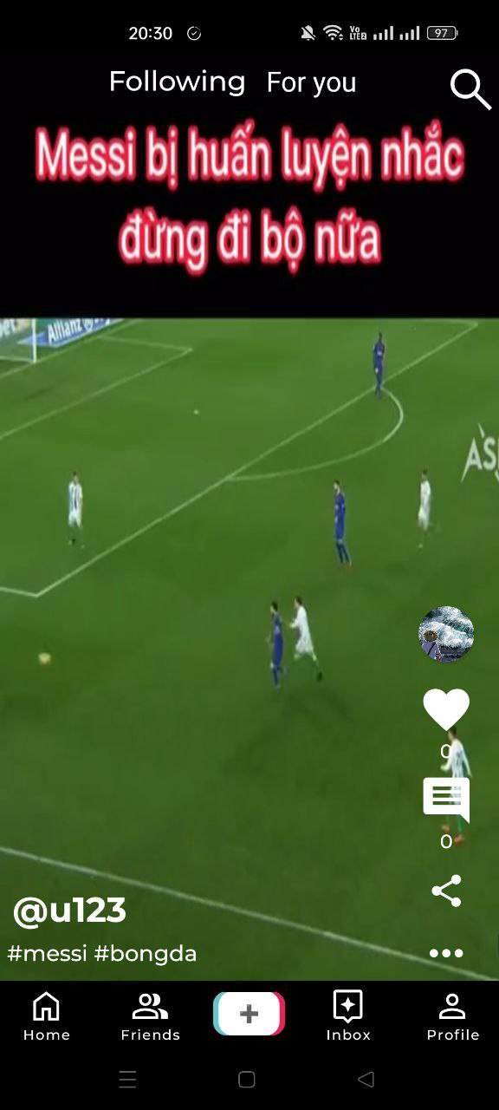
8. Demo a test case
At home screen, click on “+” button.

Slide 22
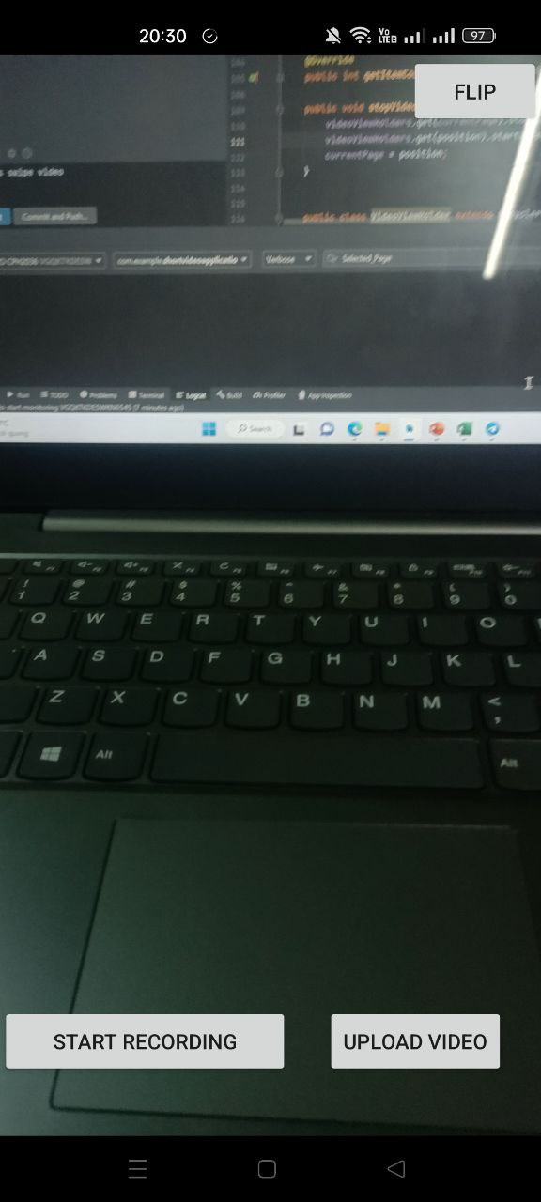
8. Demo a test case
At camera screen, click on “upload video” button.

Slide 23
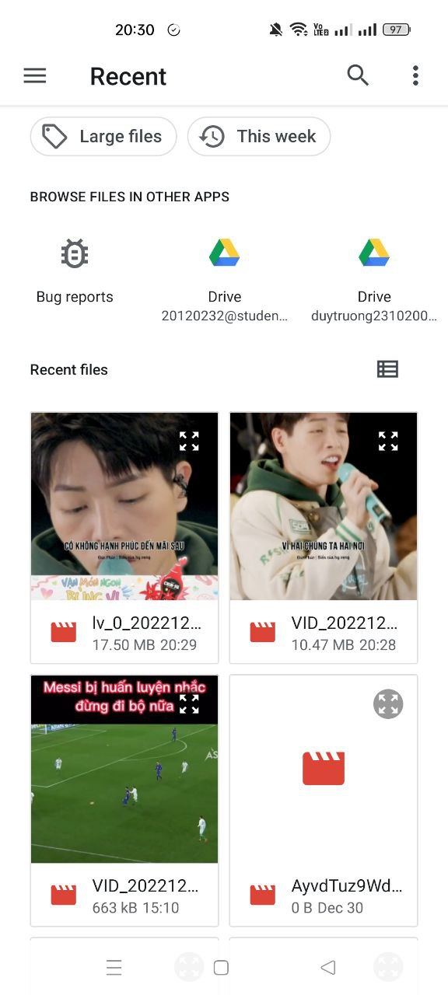
8. Demo a test case
Choose a video.

Slide 24
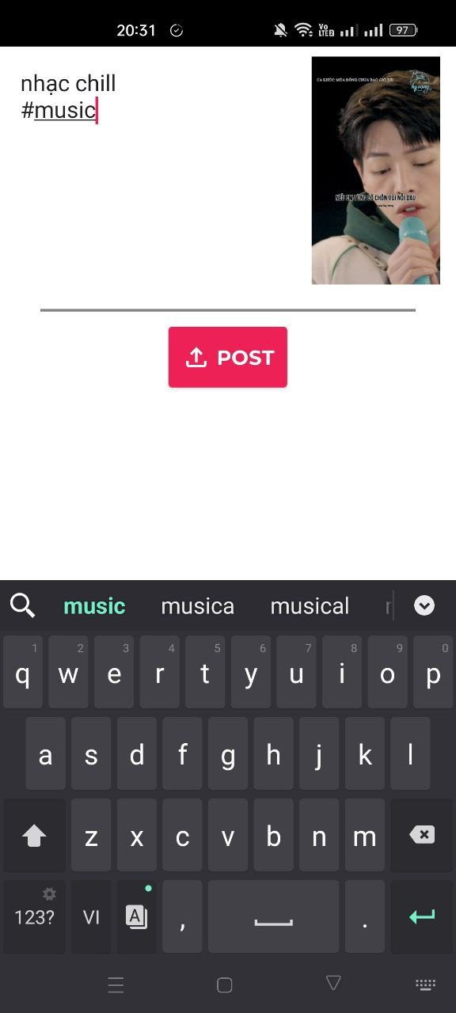
8. Demo a test case
Enter description and then click on post.

Slide 25
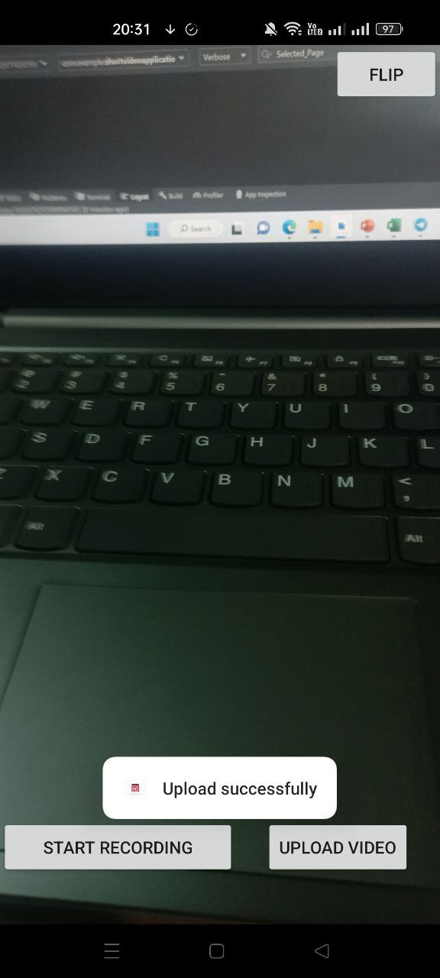
8. Demo a test case
Return camera screen and a notification will be showed.

Slide 26
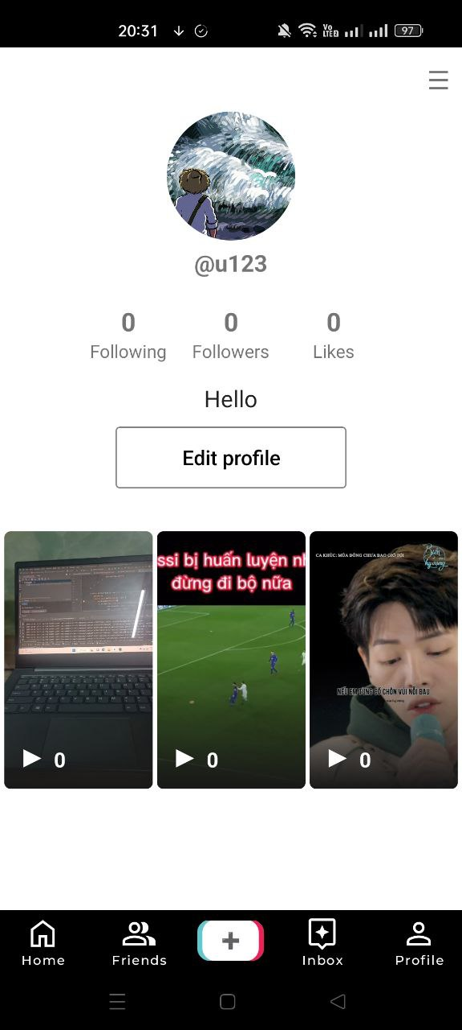
8. Demo a test case
Go to profile to check if video is in list or not.

Slide 27
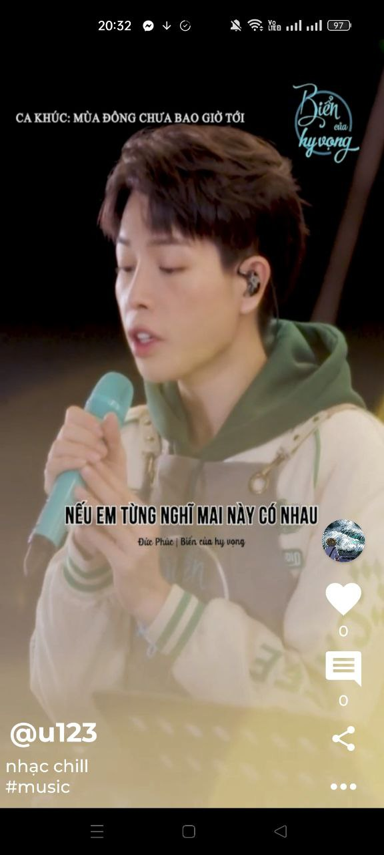
8. Demo a test case
Click on video’s thumbnail to watch it.

Slide 28
Contribution
ID | Name | Tasks | Contribution
20120232 | Võ Duy Trường | Sign up (phone), design ui, react video, comment, add camera | 24%
20120188 | Lê Trần Thiện Thắng | Sign in (phone), design ui, follow/unfollow, search, watch video | 19%
20120215 | Trần Minh Toàn | Design ui, follow/unfollow, design profile, upload video | 19%
20120175 | Lê Thái Như Quỳnh | Edit profile, design profile, react video, comment, design ui | 20%
20120382 | Hoàng Thu Thủy | Design database, notification, sign out, authentication (email), design ui | 18%

Slide 29
THANK YOU

